Slide 1

Predicting Marketing Targets in Banking
Sai Meghana Devarasetty

Slide 2
Introduction
Background: Banks regularly conduct marketing campaigns to promote term deposit products. These campaigns are often broad in scope, targeting large customer bases, but result in low conversion rates. As a result, significant marketing resources are spent on individuals who are unlikely to subscribe.
Problem Statement: The challenge is to accurately predict which customers are likely to subscribe to a term deposit based on demographic, financial, and campaign-related attributes. This can help banks focus their marketing efforts more effectively.
Goal of the Project: The primary goal is to develop a predictive machine learning model that identifies customers with a high likelihood of responding positively to term deposit offers. This supports more efficient customer targeting and resource allocation.
Business Importance:
Enables improved customer segmentation for campaign planning
Enhances marketing effectiveness through personalized offers
Reduces costs by minimizing outreach to low-probability responders
Improves customer engagement and overall return on marketing investment

Slide 3
Aims and objectives
Aim: To develop a predictive model that classifies customers likely to subscribe to a term deposit using demographic and campaign data.
Objectives:
Analyze the structure and characteristics of banking campaign data.
Build and compare multiple classification models (Logistic Regression, Naive Bayes, LDA, QDA, Decision Trees).
Include interaction terms and dimensionality reduction (PCA) for enhancement.
Evaluate performance using metrics: Accuracy, AUC, Precision, Recall, F1 Score.
Tune models for optimal results.

Slide 4
Data Description
Source:
Dataset from a real Portuguese bank marketing campaign
Kaggle URL
Shape:
Training Data: 45,211 observations, 17 variables
Test Data: 4,521 observations
Variable Types:
Categorical: job, marital, education, default, housing, loan, contact, month, poutcome
Numerical: age, balance, day, duration, campaign, pdays, previous
Target: y (term deposit subscribed: yes/no)

Slide 5
Data Structure
Feature | Type | Description
age | Numeric | Age of the customer
job | Categorical | Job type
marital | Categorical | Marital status
education | Categorical | Education level
default | Categorical | Has credit in default
balance | Numeric | Average yearly balance
housing | Categorical | Has a housing loan
loan | Categorical | Has a personal loan
contact | Categorical | Contact communication type
duration | Numeric | Duration of the last contact (in sec)
campaign | Numeric | Contacts during the campaign
pdays | Numeric | Days since last contact
previous | Numeric | Number of contacts before this campaign
poutcome | Categorical | Previous campaign outcome
y | Categorical | Subscribed to term deposit (Target)

Slide 6
Data Quality
Missing Values: No missing values in the dataset and no duplicates rows Class Balance:
y = no: Majority class
y = yes: Minority class → Slight imbalance, but still suitable for classification

Slide 7
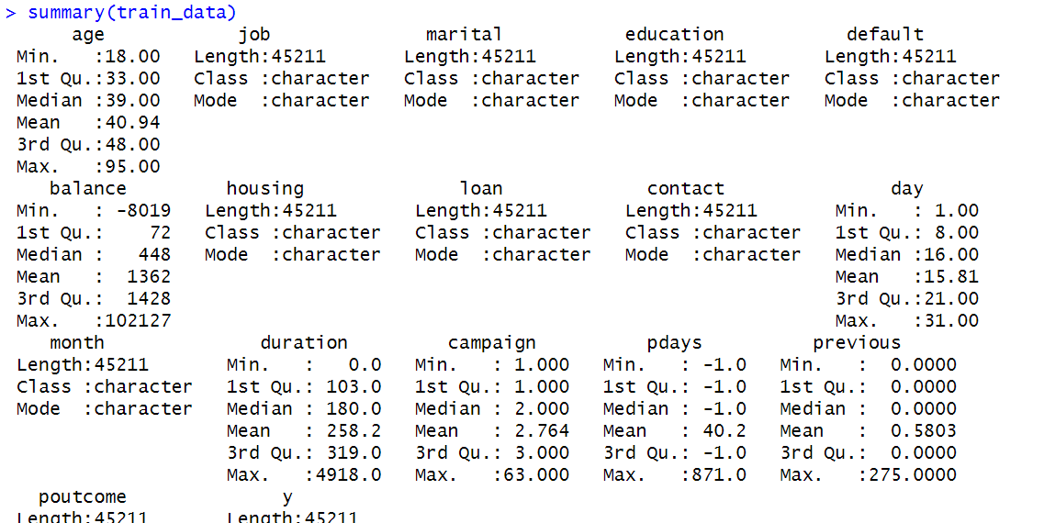
Data Summary
1. Age Distribution
The majority of customers are between 30 and 50 years old.
A few customers are older than 70, indicating a wide age range among respondents.
2. Job and Subscription
Customers in roles such as retired, student, and management showed higher subscription rates.
Blue-collar and unemployed groups showed comparatively lower interest in term deposits.
3. Education Impact
Higher education levels (tertiary) are associated with greater subscription rates.
Customers with unknown education tend to have lower response rates.
4. Loan and Housing Status
Customers without personal or housing loans were more likely to subscribe.
Loan commitments may reduce willingness to engage in long-term savings.
5. Contact Duration
Call duration is a strong predictor. Longer calls often correlate with successful subscriptions.
Most successful contacts had durations above 300 seconds.

Slide 8
Data Cleaning steps
Data Cleaning
Checked for missing values — None found
Verified variable types and converted categorical variables to factors
2. Feature Engineering
Interaction Terms: Created pairwise product terms between numeric features
Squared Terms: Added squared values of numeric features
PCA: Applied Principal Component Analysis to reduce dimensionality
Retained components explaining ≥95% variance
3. Feature Scaling
Applied scale() to standardize numeric features (mean = 0, SD = 1)
Used training data’s scaling parameters for test data to prevent data leakage
4. Encoding
Converted string-based categorical variables (e.g., job, education) to factors
Ensured target variable y was a factor with levels: no, yes

Slide 9
Modeling Steps
Step 1: Dataset Splitting
Training Data: 45,211 records
Test Data: 4,521 records
Evaluated models on original, interaction-enhanced, and PCA data versions
Step 2: Model Selection Built and evaluated the following classification models:
Logistic Regression
Naive Bayes
Linear Discriminant Analysis (LDA)
Quadratic Discriminant Analysis (QDA)
Decision Tree (rpart)
Step 3: Model Evaluation
Metrics Used: Accuracy, AUC, Precision, Recall, F1 Score
Plotted ROC curves for comparison
Step 4: Model Enhancement
Created interaction and squared terms for deeper modeling
Applied PCA for dimensionality reduction
Performed 5-fold cross-validation using caret::train()
Tuned models with hyperparameter grids (e.g., lambda in glmnet, cp in rpart)

Slide 10
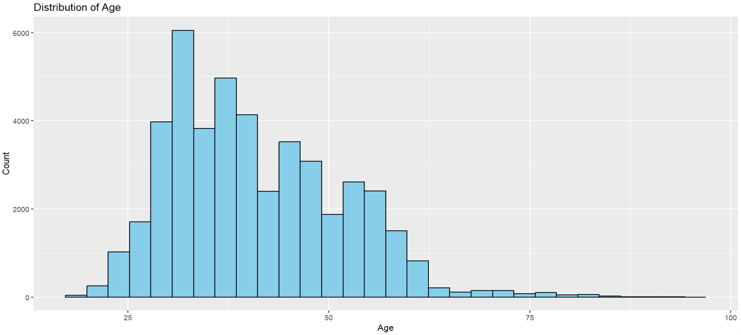
Visual analysis
The age distribution is right-skewed, with most customers falling between 25 and 50 years old. The peak frequency is around 30 to 35 years, indicating that this age group forms the core of the bank’s marketing base. Very few customers are older than 70, suggesting that senior citizens are underrepresented in this campaign.

Slide 11
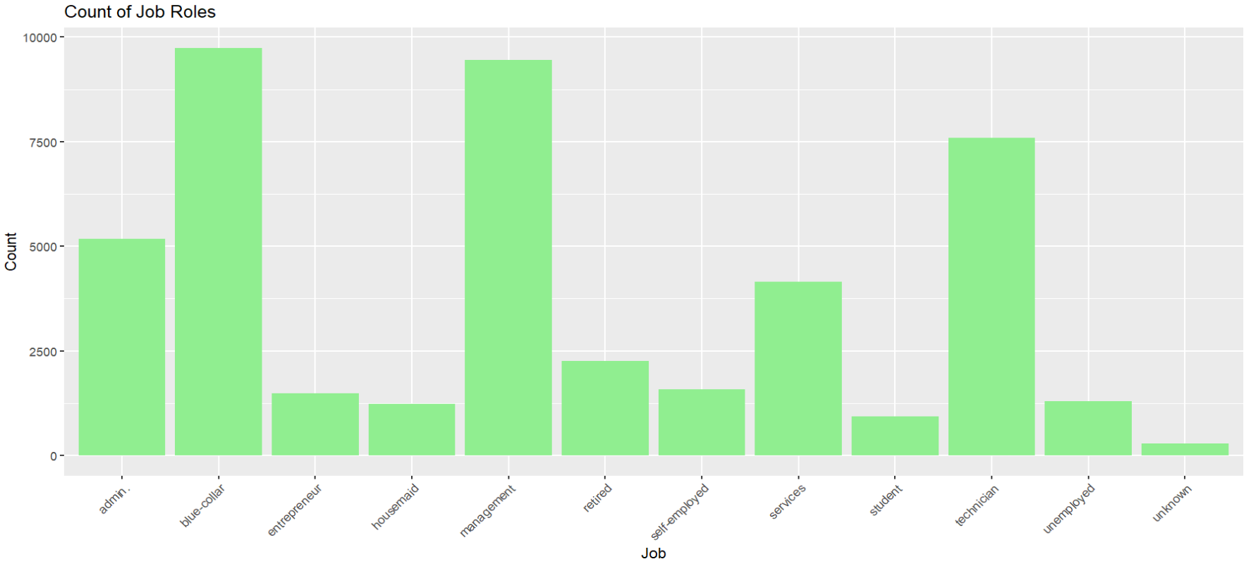
The most common job roles among customers are blue-collar, management, and technician, each with high representation. Roles such as student, housemaid, and unknown have the lowest counts. This indicates that the campaign reached a wide variety of professions, but was heavily skewed toward working-class and professional segments.

Slide 12
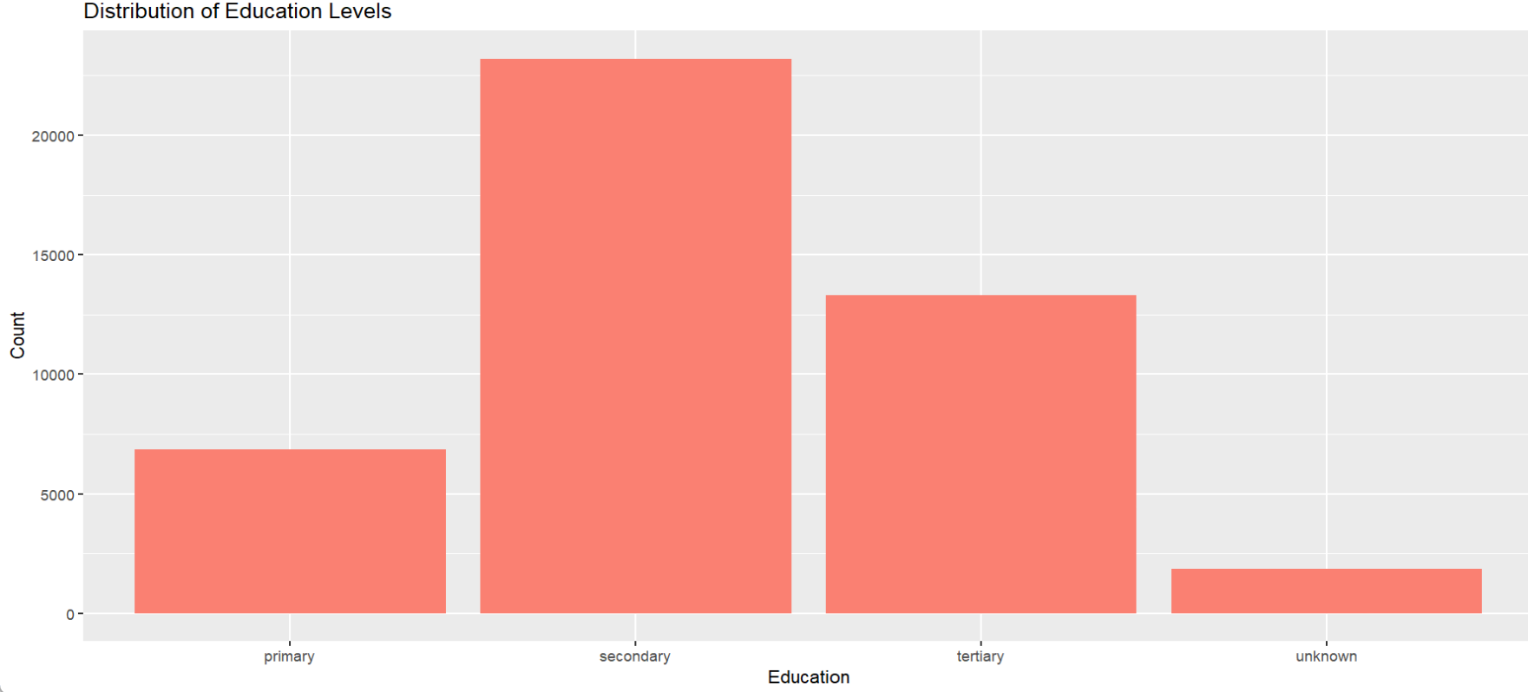
The majority of customers have a secondary education, followed by tertiary and primary levels. A small portion of the data has unknown education. This suggests that the customer base is relatively well-educated, with a large pool potentially having the financial awareness required for term deposit decisions.

Slide 13
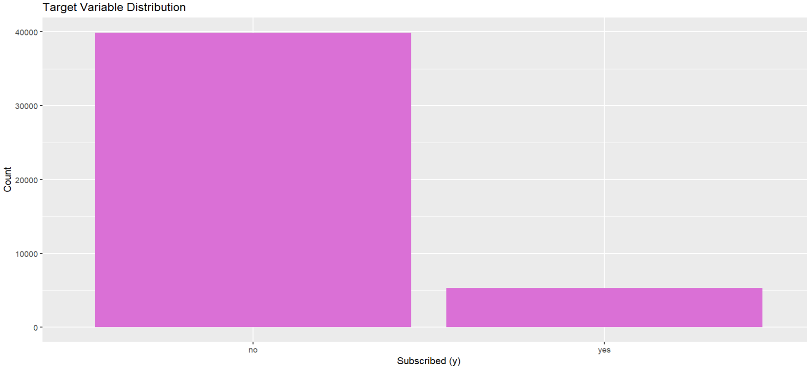
The distribution of the target variable y is highly imbalanced, with a large majority of customers not subscribing to the term deposit. Only a small fraction of the responses are positive ("yes").

Slide 14
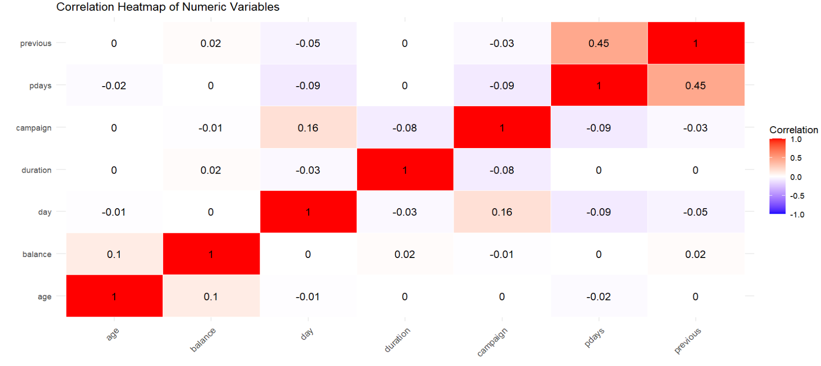
Correlation analysis
The correlation among numeric variables is generally very weak, with most values close to zero. The only moderately positive correlation is between pdays and previous (0.45), suggesting customers contacted previously tend to have non-missing pdays.

Slide 15
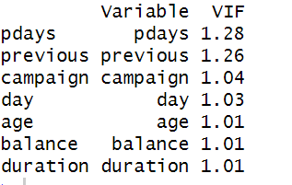
VIF Analysis (check multicollinearty)
All variables have VIF values close to 1, indicating little to no multicollinearity among the numeric predictors. The highest VIF is 1.28 for pdays, which is still well below the common threshold of 5 or 10.

Slide 16
Interaction terms
Capturing Non-Linear Relationships
Squared terms allow the model to capture effects that increase or decrease non-linearly
Example: The influence of age or duration may not be constant across all values
Understanding Variable Interactions
Interaction terms reveal how the combination of two features impacts the target
Example: A long call (duration) may have different effects depending on how recently the customer was contacted (pdays)
Enhancing Model Predictive Power
Expands the feature space to allow more flexible and accurate modeling
Improves the model’s ability to reflect complex customer decision-making patterns
No Multicollinearity Concern
All numeric variables have low VIF values (near 1)
Adding interactions does not introduce instability due to correlated predictors

Slide 17
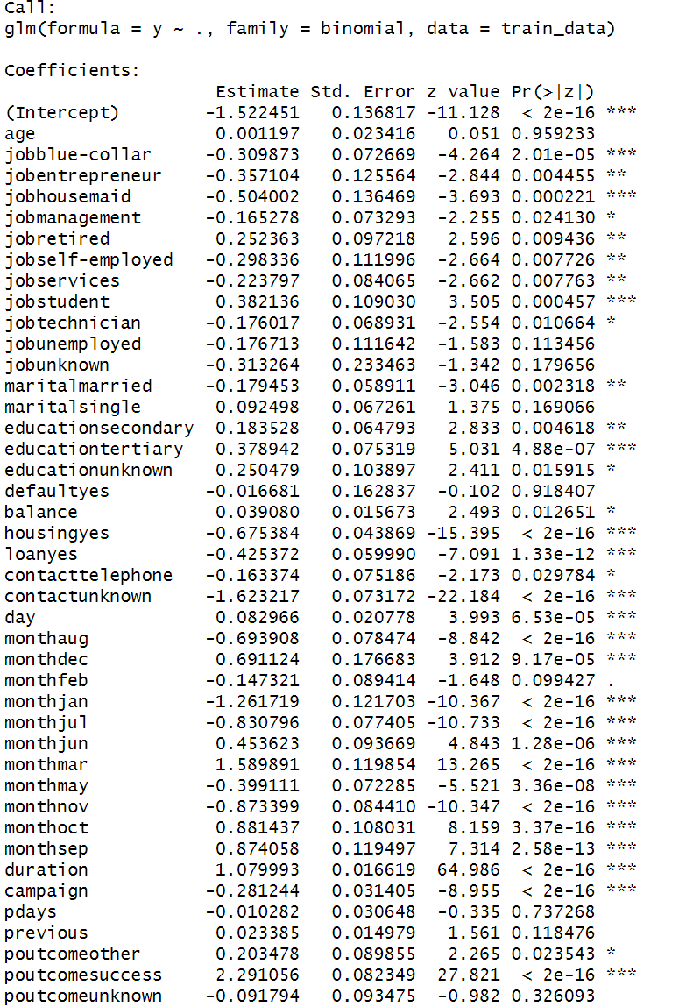
Logistic Regression
Significant Predictors (p < 0.05):
Job:
Negative impact: blue-collar, entrepreneur, housemaid, management, self-employed, services, technician
Positive impact: retired, student
Marital Status:
Being married reduces likelihood compared to the base group (divorced)
Education:
Tertiary, secondary, and unknown education positively influence subscription likelihood
Financial & Loan Features:
Higher balance → slight positive effect
Housing loan (yes) and personal loan (yes) → strong negative influence
Contact Information:
Contact by unknown method or telephone → negative effect
Month of Contact:
Best-performing months: mar, oct, sep, jun, dec
Worst-performing months: jan, jul, may, nov, aug
Call Duration:
Strong positive predictor (duration, coefficient = 1.08, p < 2e-16)
Campaign Features:
Higher campaign contacts → negative effect
poutcomesuccess from previous campaigns → very strong positive effect
poutcomeother from previous campaigns → slight positive effect
Not Significant Predictors (p > 0.05):
age, jobunemployed, jobunknown, maritalsingle, defaultyes, monthfeb, pdays, previous, poutcomeunknown → These variables show no statistically significant impact on subscription in this model.

Slide 18
Model performance
Models trained on full variables
Model | Accuracy | Precision | Recall | F1 Score | AUC
Logistic Regression | 0.902 | 0.647 | 0.334 | 0.441 | 0.897
Naive Bayes | 0.876 | 0.465 | 0.503 | 0.483 | 0.847
LDA | 0.900 | 0.595 | 0.422 | 0.494 | 0.899
QDA | 0.868 | 0.434 | 0.468 | 0.451 | 0.830
Decision Tree | 0.900 | 0.625 | 0.332 | 0.434 | 0.742
Best Accuracy: Logistic Regression (0.902), LDA (0.900), and Decision Tree (0.900) show very similar top accuracy.
Best Precision: Logistic Regression (0.647) has the highest precision, indicating fewer false positives.
Best Recall: Naive Bayes (0.503) captures the most true positives, making it more sensitive.
Best F1 Score: LDA (0.494) balances precision and recall better than others.
Best AUC: LDA (0.899) and Logistic Regression (0.897) show the best ability to distinguish between classes overall.

Slide 19
Model performance
Model | Accuracy | Precision | Recall | F1 Score | AUC
Logistic Regression + Interactions | 0.903 | 0.638 | 0.372 | 0.470 | 0.904
Naive Bayes + Interactions | 0.837 | 0.330 | 0.399 | 0.361 | 0.813
LDA + Interactions | 0.899 | 0.580 | 0.453 | 0.509 | 0.903
QDA + Interactions | 0.856 | 0.409 | 0.564 | 0.475 | 0.871
Decision Tree + Interactions | 0.900 | 0.625 | 0.332 | 0.434 | 0.742
Models trained on full variables with Best Overall Performance: Logistic Regression with interactions performs best in terms of AUC (0.904) and accuracy (0.903), suggesting strong discrimination ability and good fit.
Best Recall (Sensitivity): QDA with interactions achieves the highest recall (0.564), making it the most sensitive model in identifying actual subscribers.
Best Precision: Logistic Regression (0.638) and Decision Tree (0.625) provide the highest precision, indicating fewer false positives.
Best F1 Score: LDA with interactions shows the best balance between precision and recall with an F1 score of 0.509.
Weakest Performer: Naive Bayes with interactions underperforms across all key metrics, especially precision (0.330) and F1 score (0.361).

Slide 20
Models trained on PCA components
Model | Accuracy | Precision | Recall | F1 Score | AUC
Logistic Regression (PCA) | 0.885 | 0.529 | 0.052 | 0.094 | 0.826
Naive Bayes (PCA) | 0.844 | 0.304 | 0.274 | 0.288 | 0.754
LDA (PCA) | 0.885 | 0.507 | 0.071 | 0.125 | 0.829
QDA (PCA) | 0.851 | 0.359 | 0.372 | 0.366 | 0.801
Decision Tree (PCA) | 0.887 | 0.540 | 0.104 | 0.174 | 0.364
Best AUC: Logistic Regression (0.826) and LDA (0.829) with PCA perform best in terms of AUC, indicating better discrimination between classes.
Highest Recall: QDA (0.372) is most sensitive in detecting actual subscribers, similar to its behavior in original and interaction-based models.
Highest Precision: Decision Tree (0.540) and Logistic Regression (0.529) achieve the best precision, though recall remains very low.
Best F1 Score: QDA (0.366) shows the best balance between precision and recall, making it the most stable model among PCA-based options.
Best Accuracy:
Decision Tree (0.887), Logistic Regression (0.885), and LDA (0.885) showed the highest accuracy.

Slide 21
Tuned Performance
No tuning grids or validation curves were applied to LDA and QDA
Instead, we evaluated them directly on the training data with different feature sets (main effects, interactions, PCA)
Model | Feature Set | Accuracy | Precision | Recall | F1 Score | AUC
Logistic Regression (Tuned) | Original | 0.900 | 0.655 | 0.276 | 0.389 | 0.900
Logistic Regression (Tuned) | Interaction | 0.903 | 0.674 | 0.298 | 0.413 | 0.904
Naive Bayes (Tuned) | Original | 0.885 | NA | 0.000 | NA | 0.866
Naive Bayes (Tuned) | Interaction | 0.886 | 0.857 | 0.012 | 0.023 | 0.886
Decision Tree (Tuned) | Original | 0.915 | 0.678 | 0.493 | 0.571 | 0.867
Decision Tree (Tuned) | Interaction | 0.920 | 0.712 | 0.507 | 0.592 | 0.885
Logistic Regression (Interaction) slightly improves over the original in all metrics, especially F1 Score (from 0.389 to 0.413), showing that interaction terms add value.
Naive Bayes (Tuned) fails to generalize well on both sets:
On original data, it predicts only one class (all "no").
On interaction data, although precision is high, recall is very poor, leading to a near-zero F1 Score.
Decision Tree (Tuned) outperforms all other models:
Highest Accuracy (0.920), Precision (0.712), Recall (0.507), and F1 Score (0.592)
Strong AUC (0.885), indicating reliable class separation.

Slide 22
Summary
After evaluating multiple classification models across three feature settings — original features, interaction terms, and PCA-transformed features — the Tuned Decision Tree using interaction terms emerged as the most effective model overall (including best overall Accuracy and F1 Score).
Interaction terms enhanced performance Most models improved when interaction and squared terms were included, indicating non-linear relationships and feature interactions matter for term deposit prediction.
Logistic Regression performed consistently under different circumstances, showing consistency within the model type.
PCA models underperformed in recall and F1 score, likely due to loss of interpretability and important feature-specific signals during dimensionality reduction.
Naive Bayes performed poorly even after tuning, especially on recall, highlighting its limitations under complex feature interactions and imbalance.

